Slide 1
Chapter 16

Slide 2
Objectives

Slide 3
Objectives (continued)

Slide 4
What happens when a data structure is serialized and deserialized

Slide 5
Four common data formats

Slide 6
Examples of the data formats

Slide 7
Some of the benefits of JavaScript Object Notation (JSON)

Slide 8
Some of the JSON rules

Slide 9
An object represented in JSON

Slide 10
JSON support in JavaScript

Slide 11
The methods of the JSON object

Slide 12
How to use the stringify method

Slide 13
How to use the stringify method (continued)

Slide 14
The syntax of the parse method of the JSON object

Slide 15
How to use the parse method

Slide 16
How the parse method handles date strings

Slide 17
When the parse method throws a SyntaxError exception...

Slide 18
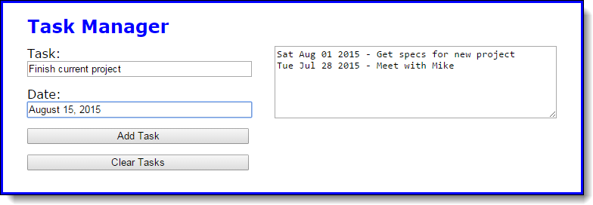
The Task Manager application

Slide 19
The HTML

Slide 20
The JSON string stored in local storage

Slide 21
The main JavaScript file

Slide 22
The main JavaScript file (continued)

Slide 23
The main JavaScript file (continued)

Slide 24
How the toJSON method affects the stringify method

Slide 25
How the toJSON method affects the stringify method (continued)

Slide 26
When you might use the toJSON method

Slide 27
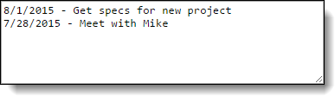
The tasks displayed in the customized Task Manager application

Slide 28
The JSON string stored in local storage

Slide 29
The library_task.js file

Slide 30
The updated displayTaskList function of the main JavaScript file

Slide 31
The syntax of the replacer parameter of the stringify method

Slide 32
How a replacer function works

Slide 33
The objects to be serialized

Slide 34
How to use a replacer parameter that’s a function

Slide 35
How to use a replacer parameter that’s an array

Slide 36
How the space parameter of the stringify method works

Slide 37
The object to be serialized

Slide 38

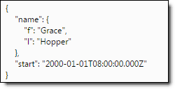
How to use a space parameter

Slide 39
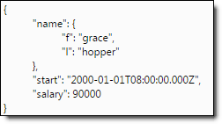
How to use a space parameter (continued)

Slide 40
The serialization order of the stringify method

Slide 41
Stringifying an object

Slide 42
Stringifying the object (continued)

Slide 43
Stringifying the object (continued)

Slide 44
The syntax of the reviver parameter of the parse method

Slide 45
The JSON string to be deserialized

Slide 46
Use a reviver parameter to convert any date string to a Date object

Slide 47
Add an additional property to any Date object

Slide 48
Convert the name object to a string

Slide 49
Some values that aren’t dates but convert to valid Date objects

Slide 50
Some ways to check whether a string is a date

Slide 51
Typical usage of the Object toString method for checking dates

Slide 52
Some third-party libraries for working with dates

Slide 53

The Task Manager application

Slide 54
The JSON string stored in local storage

Slide 55
The library_storage.js file

Slide 56
The library_storage.js file (continued)

Slide 57
The library_storage.js file (continued)

Slide 58
The main JavaScript file

Slide 59
The main JavaScript file (continued)

Slide 60
The main JavaScript file (continued)

Slide 61
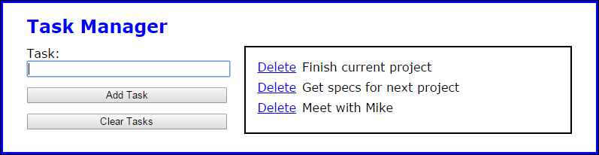
Exercise 16-1 Convert Task Manager to JSON

Slide 62
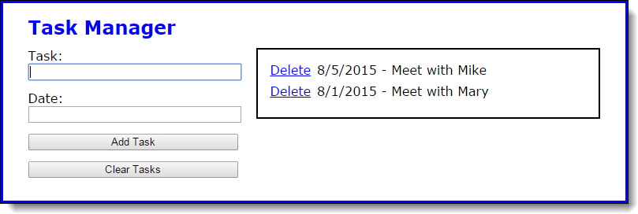
Exercise 16-2 Add date field and toJSON method

Slide 63

Exercise 16-3 Add a reviver function

Slide 64
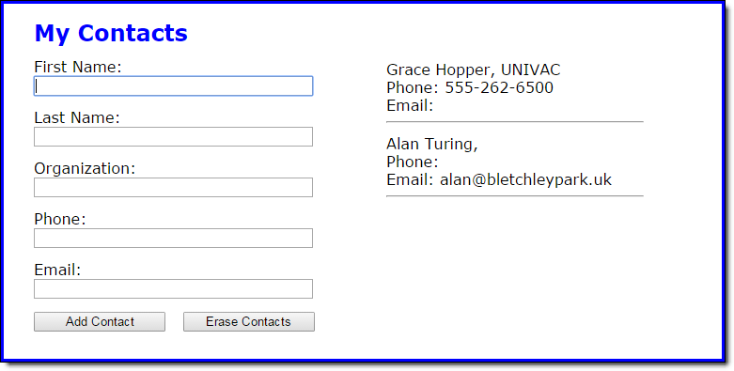
Extra 16-1 Use JSON with a Contact List app

Slide 65
Extra 16-2 Use replacers and revivers

Slide 66
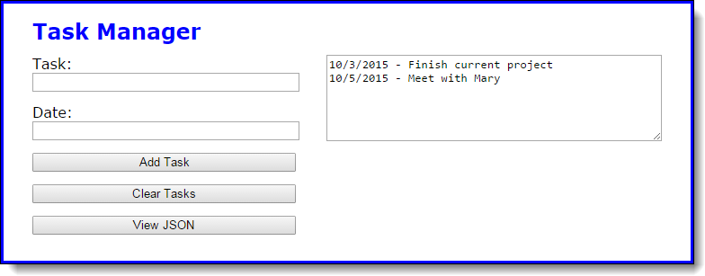
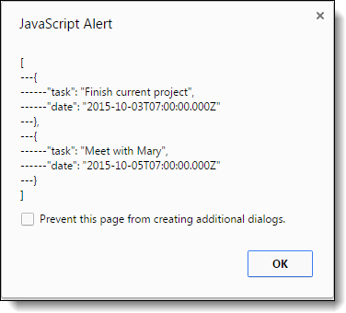
Short 16-1 Display a JSON string

